Slide 1



Liquid biopsies in clinical trials
NICTC Meeting, Queen’s University
4th August 2022
Dr. Alexander W Wyatt, D.Phil
Assistant Professor, University of British Columbia
Senior Research Scientist, Vancouver Prostate Centre
Scientist, Canada’s Michael Smith Genome Sciences Centre, BC Cancer
Twitter @ResearchWyatt

Slide 2
Disclosures
I have served on advisory boards and/or received honoraria from AstraZeneca, Astellas, Janssen, and Merck.
My laboratory has a contract research agreement with ESSA Pharma
No other relationships/conditions/circumstances that present a potential conflict of interest

Slide 3
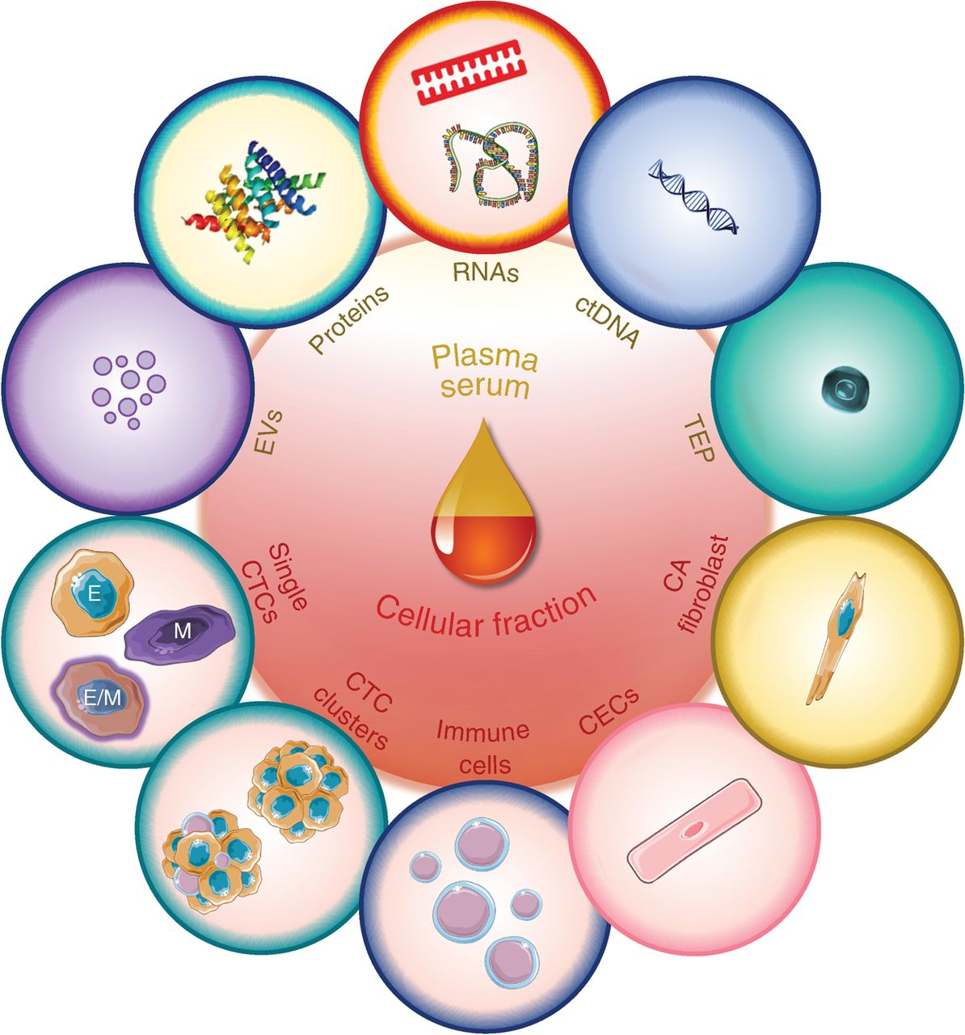
The liquid biopsy
ctDNA = a minimally-invasive source of material to study the tumour genome
Catherine Alix-Panabières and Klaus Pantel, Cancer Discovery 2021

Slide 4
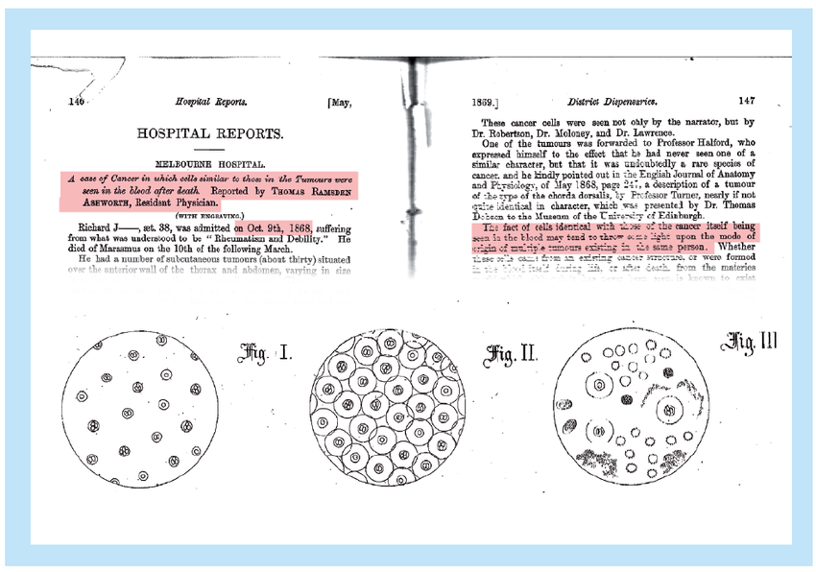
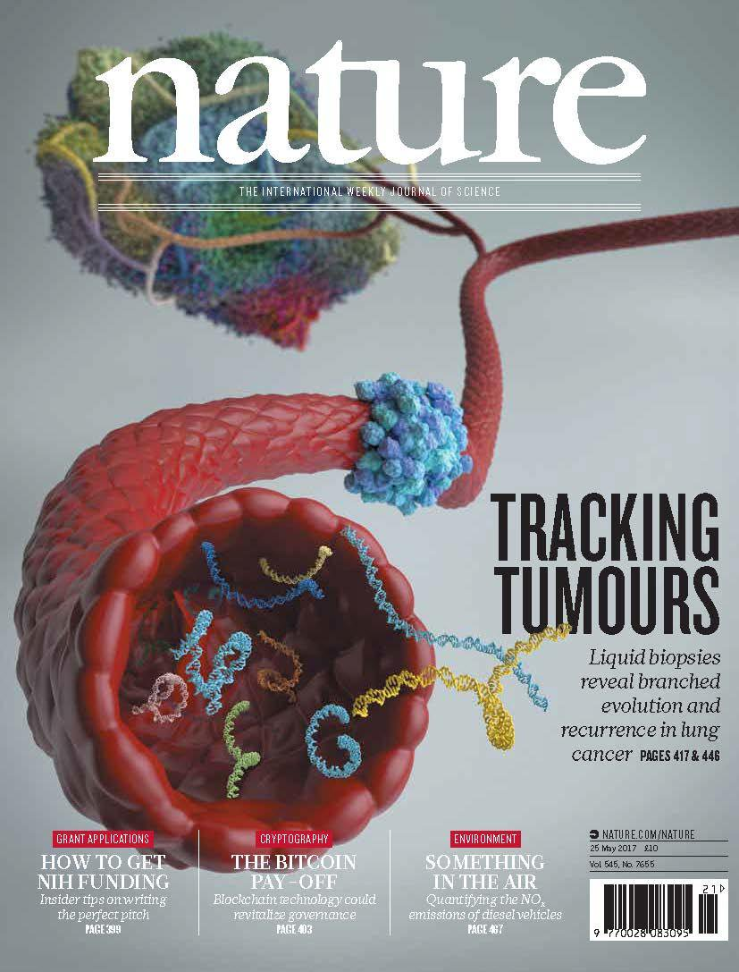
The promise of the “liquid biopsy” in 1869!
Thomas Ashworth (pathologist), 1869

Slide 5

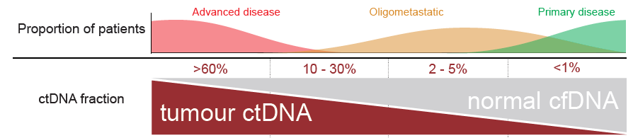
What is plasma circulating tumour DNA (ctDNA)?
Short fragments (post-apoptotic) of tumour DNA in the blood
Mixed with cell-free DNA from non-cancer cells (leukocytes)
Half-life = hours
CtDNA abundance is associated with proliferative tumour burden
?
Vandekerkhove and Wyatt, Société Internationale d’Urologie Journal. 2020 1(1), 39-48

Slide 6
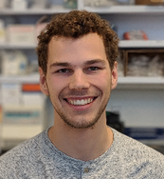
How can ctDNA tests help?
Cameron Herberts
@UBC PhD
Improve cancer screening in at-risk populations
Detect residual disease after surgery / radiation
Monitor for response / resistance to therapy
Estimate cancer aggression, i.e. prognosis
Predict treatment efficacy
Define new metastatic biology & resistance mechanisms
Detection of ctDNA
Characterization of ctDNA
Lack of recognition for the distinction between detection and characterization of ctDNA is contributing to unrealistic expectations for sensitivity in some settings

Slide 7
How can ctDNA tests help in the clinic?
Improve cancer screening in at-risk populations
Detect residual disease after surgery / radiation
Monitor for response / resistance to therapy
Estimate cancer aggression, i.e. prognosis
Predict treatment efficacy

Slide 8
Detection of ctDNA indicates residual cancer
Locally advanced bladder cancer (n = 68)
  Neo-adjuvant chemo → Cystectomy → Surveillance
ctDNA detection after Cx = imminent relapse
  Opportunity for early intervention?
NCT04138628: Treatment Of Metastatic Bladder Cancer at the Time Of Biochemical reLApse Following Radical Cystectomy (TOMBOLA)
Dr. Lars Dyrskøt et al
Christensen et al., J Clin Oncol 2019

Slide 9
How can ctDNA tests help in the clinic?
Improve cancer screening in at-risk populations
Detect residual disease after surgery / radiation
Monitor for response / resistance to therapy
Estimate cancer aggression, i.e. prognosis
Predict treatment efficacy

Slide 10
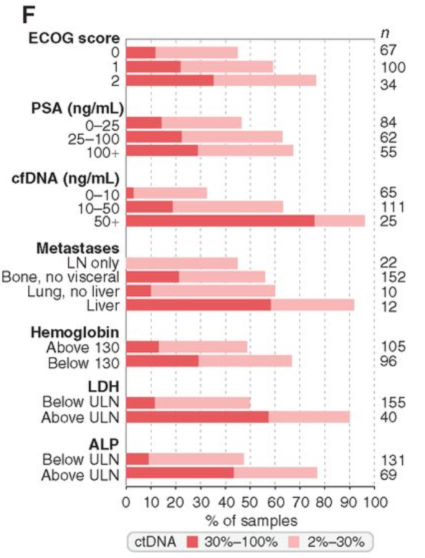
ctDNA fraction (purity) is variable in clinically-progressing metastatic prostate cancer
Metastatic burden is associated with ctDNA%
Annala et al. Cancer Discovery 2018

Slide 11
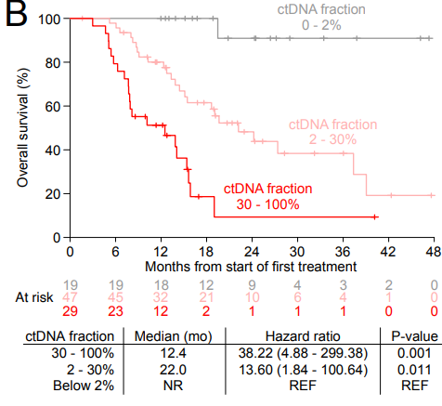
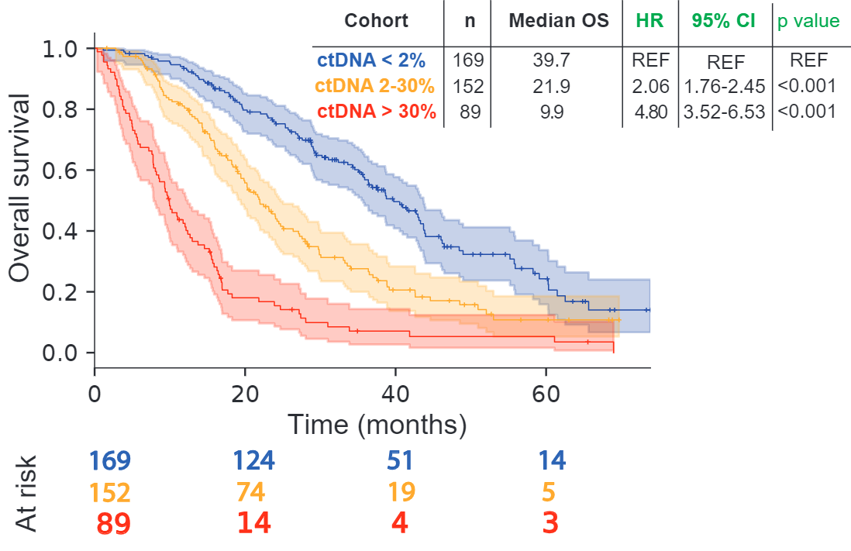

CtDNA fraction (ctDNA%) is strongly prognostic
Unselected first line mCRPC (n = 202)
Annala et al., Cancer Discov. 2018
Poor-prognosis first line mCRPC (n = 95)
Annala et al., Annals Onc. 2021
Meta-analysis first line mCRPC (n = 409)
Unpublished (Drs. Nicolette Fonseca, Corinne Maurice-Dror, Cameron Herberts)
…work in progress to better define optimal cutoffs, clinical value
High levels of ctDNA = short life expectancy with prostate cancer
Dr. Corinne Maurice-Dror
@ BC Cancer, Vancouver

Slide 12
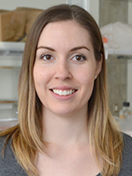
CtDNA% also prognostic in metastatic urothelial cancer
Gillian Vandekerkhove
@UBC PhD
Patient-to-patient variability in ctDNA%
High ctDNA% = short survival
High
Low
71 mUC initiating 1st line systemic tx
Suggests broad biomarker potential for an easy-to-measure blood variable
Vandekerkhove, Clinical Cancer Research 2017; Vandekerkhove, Nature Communications 2021

Slide 13
How can ctDNA tests help in the clinic?
Improve cancer screening in at-risk populations
Detect residual disease after surgery / radiation
Monitor for response / resistance to therapy
Estimate cancer aggression, i.e. prognosis
Predict treatment efficacy

Slide 14
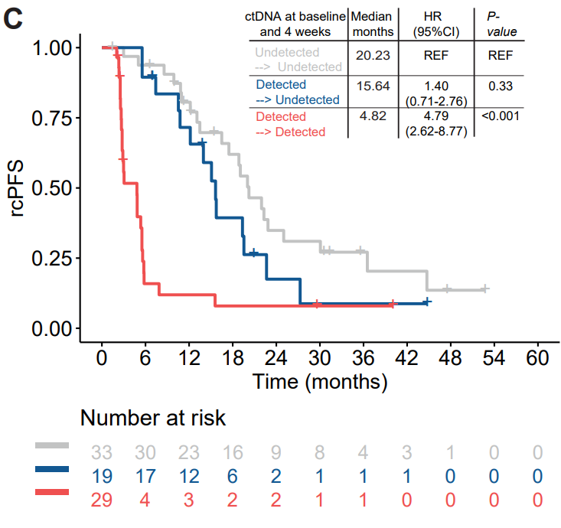
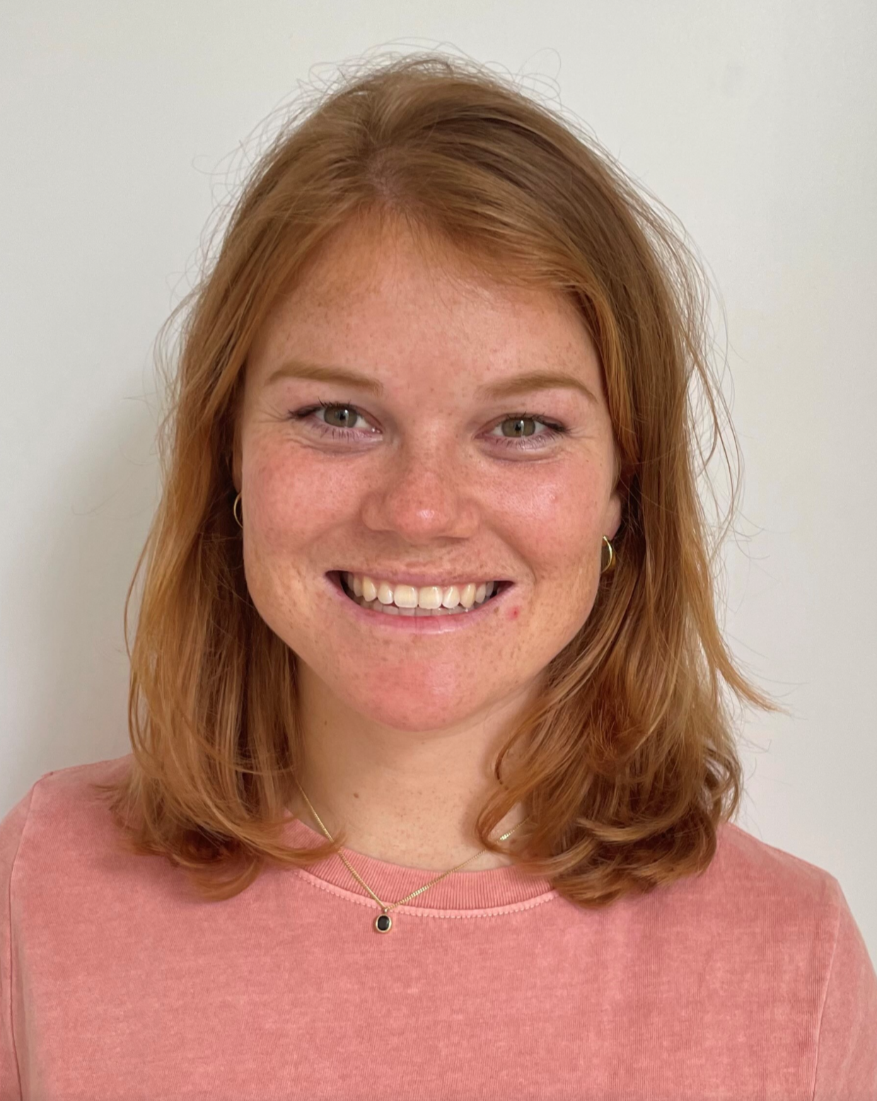
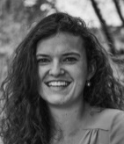
Early on-treatment ctDNA% dynamics can predict duration of treatment response
New mCRPC initiating 1L ARPI (n = 81)
Blood collections: baseline and 4-weeks
Serial sampling of newly-diagnosed metastatic prostate cancer initiating hormone therapy
Gillian Vandekerkhove, et al. Eur Urol 2019
Some pts with high ctDNA% at baseline have undetectable ctDNA by week 4
Others have persistent ctDNA at week 4
Unpublished
Emmy Boerrigter & Sofie Tolmeijer @RadboudUMC

Slide 15
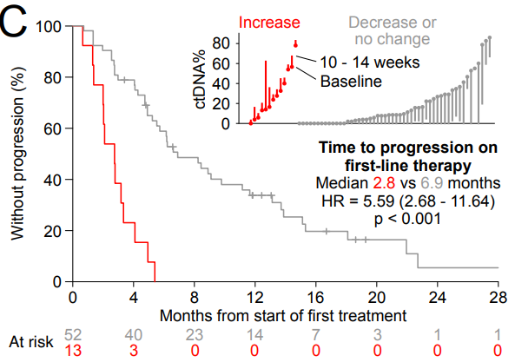
Late on-treatment ctDNA% dynamics associated with impending progression
mCRPC receiving first line tx
On-treatment ctDNA increase at 12 weeks indicates imminent progression
Annala et al., Annals Onc. 2021

Slide 16
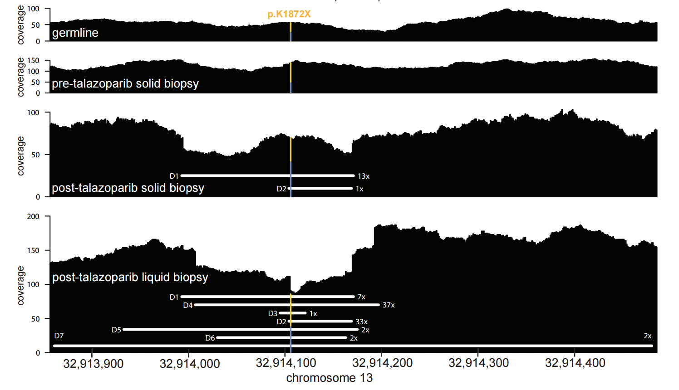
Targeted therapy selects for resistant clones
Example of reversion mutations post-PARP inhibition
mCRPC, germline BRCA2 mutation (that prevents BRCA2 from functioning)
Clinical response to PARPi
Developed progressive disease after 6 months
Serial ctDNA samples revealed development of ‘reversion mutations’
The cancer cells restore function to BRCA2
Quigley D, et al. Cancer Discovery 2017;7(9):999-1005.

Slide 17
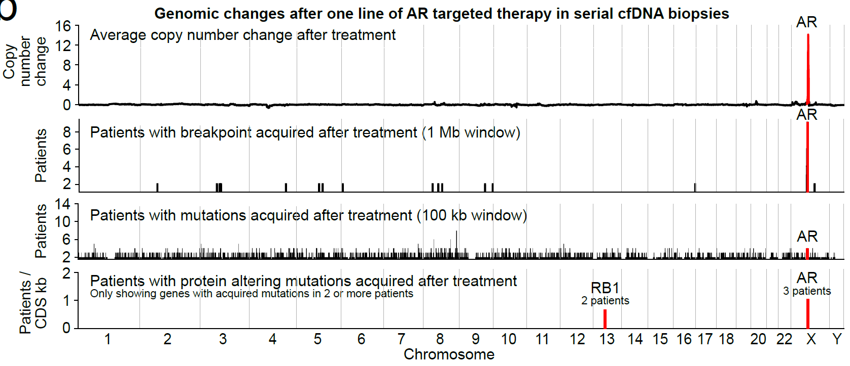
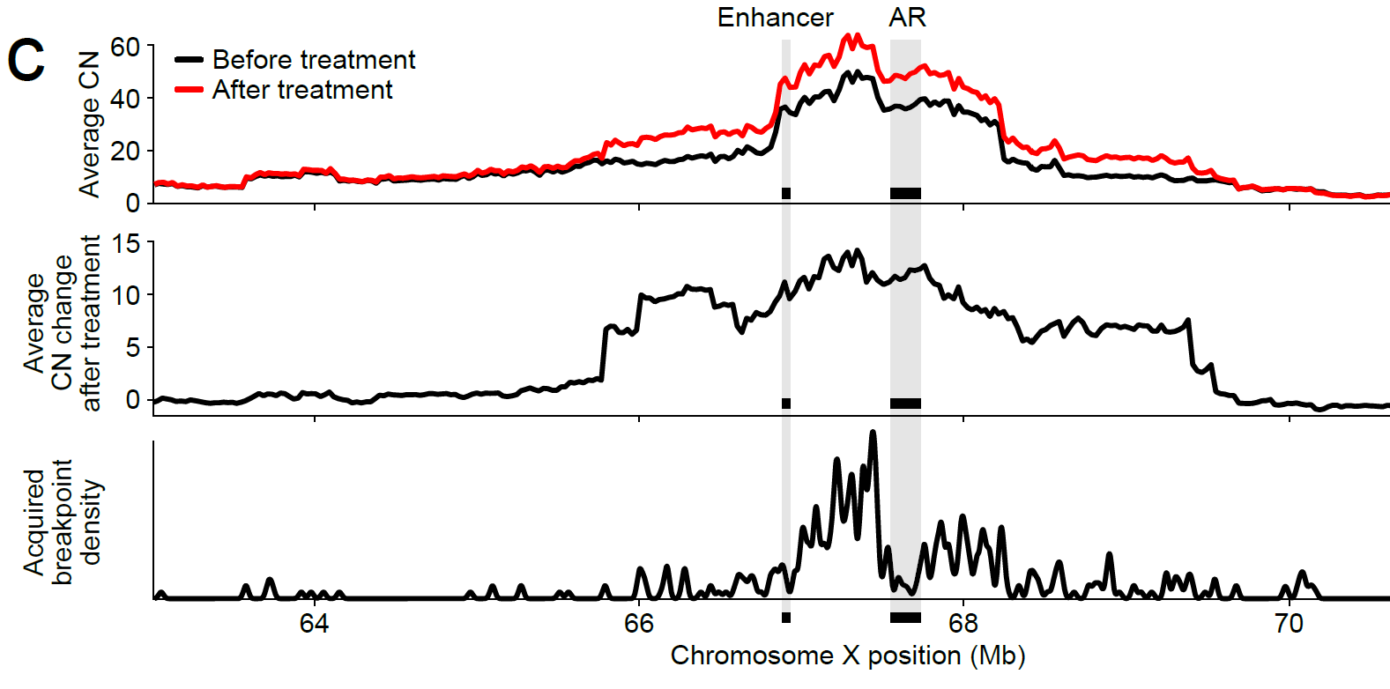
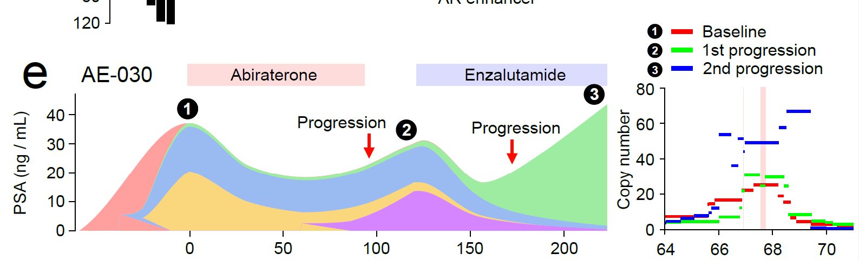

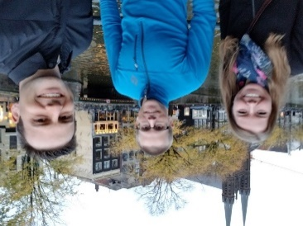

New AR genomic alterations emerge in ctDNA after sequential AR pathway inhibition
the only highly recurrent changes in copy number, mutations, or structural rearrangements were at the AR locus
Selected patient with drastic population and AR genotype changes
Herberts, Annala, Sipola, et al. Nature 2022

Slide 18
How can ctDNA tests help in the clinic?
Improve cancer screening in at-risk populations
Detect residual disease after surgery / radiation
Monitor for response / resistance to therapy
Estimate cancer aggression, i.e. prognosis
Predict treatment efficacy

Slide 19
Alterations in ctDNA can reflect clinically-relevant tumour characteristics
mUC with FGFR3 or ERBB2 alterations identified in ctDNA have high FGFR3 or ERBB2 mRNA and protein expression in matched tissue
Vandekerkhove et al., Nature Comms 2021

Slide 20
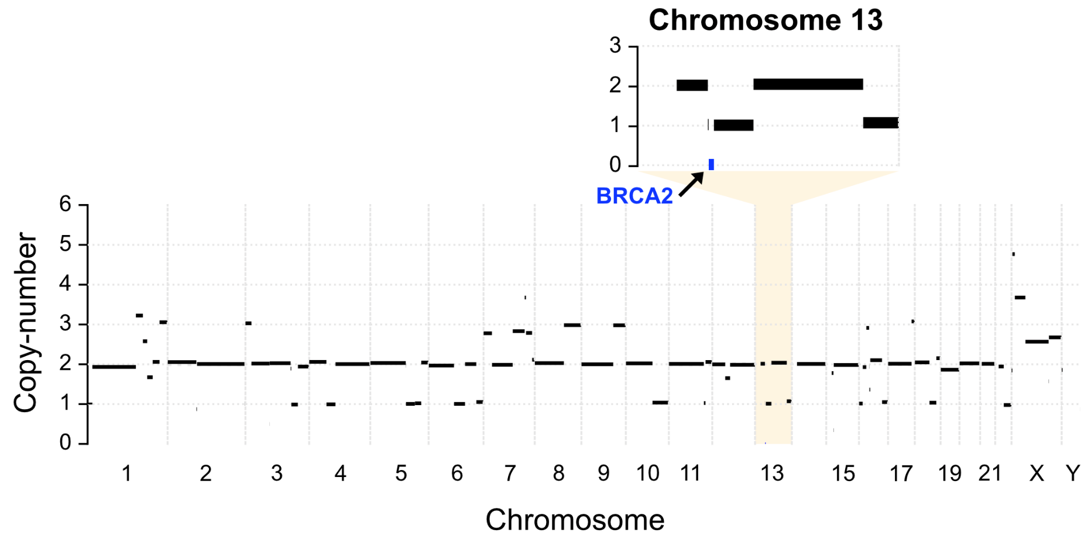
Alterations in ctDNA can reflect clinically-relevant tumour characteristics
mUC patient ctDNA
Deep whole genome sequencing (175x)
deconstructSigs: APOBEC SBS signatures (2 and 13) are highest, followed by signatures 3 (HRD) and signature 4 (smoking).
All other signatures had negligible weights.
Unpublished

Slide 21


Prospective ph2 umbrella trial using ctDNA
ClinicalTrials.gov: NCT03385655
Open-label multicentre 2-stage biomarker-driven trial
> 500 mCRPC patients screened to date
Chairs: Kim Chi, Lesley Seymour
Sub-study PIs & entire CCTG team

Slide 22
Prospective ph2 umbrella trial using ctDNA
ClinicalTrials.gov: NCT03385655
Open-label multicentre 2-stage biomarker-driven trial
> 500 mCRPC patients screened to date
Chairs: Kim Chi, Lesley Seymour
Sub-study PIs & entire CCTG team

Slide 23
How can ctDNA tests help?
Improve cancer screening in at-risk populations
Detect residual disease after surgery / radiation
Monitor for response / resistance to therapy
Estimate cancer aggression, i.e. prognosis
Predict treatment efficacy
Define new metastatic biology & resistance mechanisms
Detection of ctDNA
Characterization of ctDNA

Slide 24
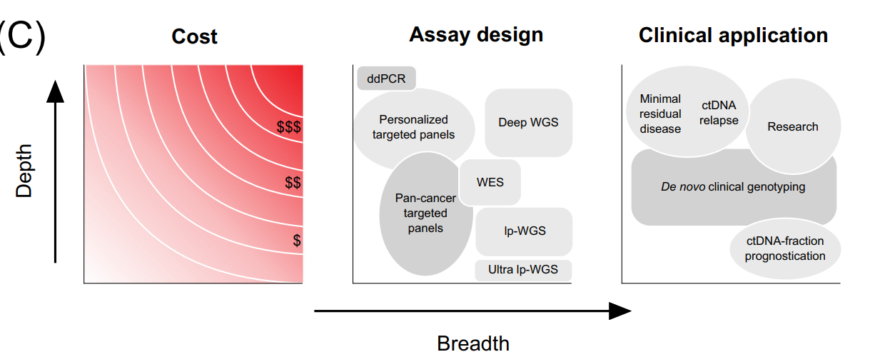


Assay design: trade-off between depth and breadth
Tumor-informed approaches; highly sensitive
Tumor-agnostic approaches; less sensitive but more comprehensive
Herberts and Wyatt, Trends in Cancer 2021

Slide 25
Limits of detection in selected ctDNA assays
Guardant360 CDx
  BRCA1/2 indel = 0.4 – 2.6% VAF (depending partly on cfDNA input volume)
  “Somatic alterations in ATM and CDK12 are not reported by the test as they are excluded from the test's reportable range.”
  Does not report copy losses
FoundationOne Liquid CDx
  BRCA1/2 or ATM indel = 0.36 – 0.51% VAF
  BRCA2 copy number loss = 48.1% TF (ctDNA fraction)
    Median LoD is 30.4% TF for copy losses across the panel
Remember: For non-recurrent alterations, LoD are rough estimates (at best). Sequence context (e.g. GC-content), mutation/deletion size, aneuploidy, input amount, etc – have a big effect

Slide 26
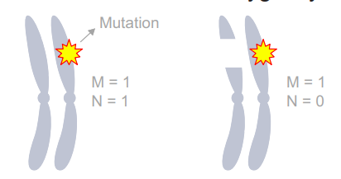
Mutations are just one mechanism of genomic alteration
Some tests will report a tumor suppressor gene mutation but not a heterozygous (monoallelic) deletion
Key cancer tumor suppressor genes RB1, TP53, CDKN2A, PTEN can be disrupted by single copy losses or complex structural rearrangements
mutation
Copy loss (deletion)
Herberts and Wyatt, Trends in Cancer 2021

Slide 27
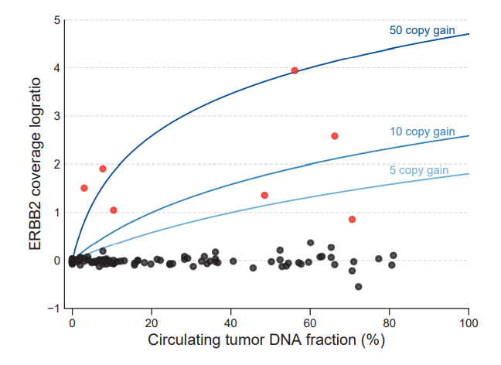
Gene amplification is not a binary variable
Copy number gain is a continuous spectrum from low to high
Absolute copy number can be biologically relevant
50
Should tests report a 50 copy gain of ERBB2 equivalent to a 5 copy gain?
5
Vandekerkhove et al., Nature Comms 2021

Slide 28
Considerations for broad panel approaches
Inclusion of rarely altered genes / pathways
Non-coding regions (introns, flanking regions)
  Identify structural rearrangements (e.g. fusions)
  Higher resolution for LOH and copy number alterations
Inclusion of genome backbone (low pass WGS)
Identify the spectrum of copy number states
  Monoallelic deletions
  Copy-neutral LOH
  Whole genome doubling
  Inform absolute amplification level (continuous variable)
Provide metrics of genome instability

Slide 29
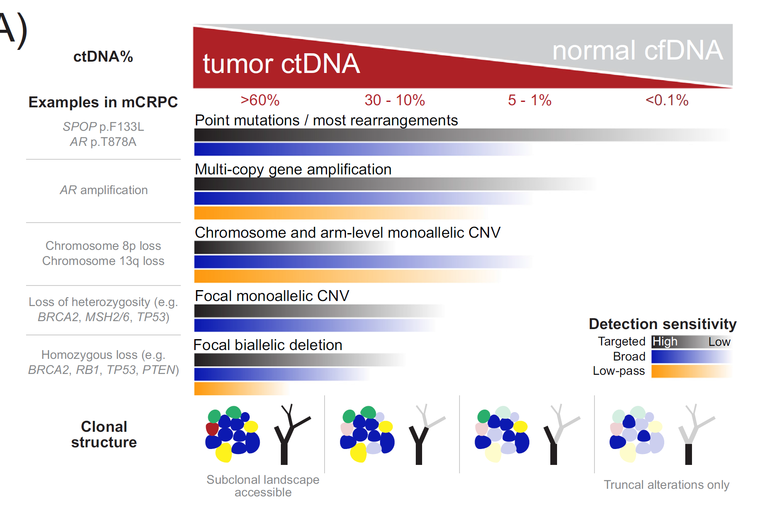
ctDNA fraction constrains the alterations that can be identified; independent of panel design
Herberts and Wyatt, Trends in Cancer 2021

Slide 30




What contributes to plasma cell-free DNA in a patient with advanced cancer?
normal (germline) cell-free DNA
from hematopoietic populations
circulating tumour DNA (ctDNA)
cancer populations; multiple sites
?
normal (germline) cell-free DNA
from non-hematopoietic tissues
-comorbidities
-treatment side effects?
-TME?
clonally-expanded hematopoietic populations with mutations (e.g. CHIP)
other somatic expansions (including independent cancers)

Slide 31
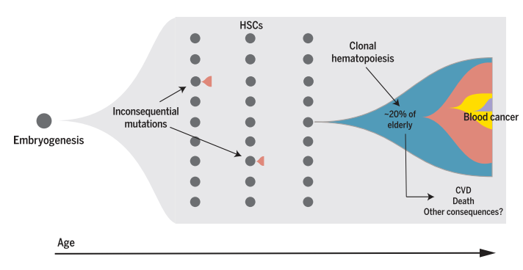
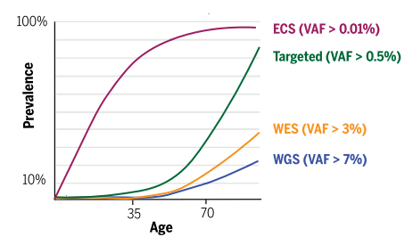
Clonal hematopoiesis of indeterminate potential (CHIP)
Prevalence increases with age
Deeper sequencing increases detection
Jaiswal and Ebert, Science 2019

Slide 32
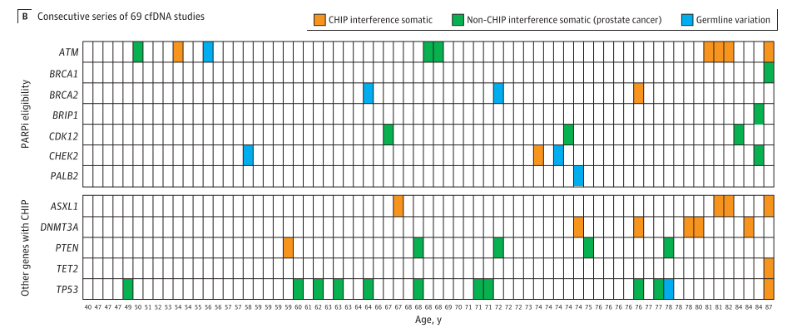
CHIP can result in false positives, if not profiling matched leukocytes
Jensen et al 2021: ~half of the cfDNA mutations in a cohort of 69 patients with advanced prostate cancer were CHIP-related
Mostly affects classic CHIP genes (e.g. DNMT3A)
Problematic for ATM/TP53.
Can give false evidence for ctDNA%!
Encourage profiling of matched white blood cells in all patients

Slide 33
How can ctDNA tests help in the clinic?
Improve cancer screening in at-risk populations
Detect residual disease after surgery / radiation
Monitor for response / resistance to therapy
Estimate cancer aggression, i.e. prognosis
Predict treatment efficacy
Characterize cancer biology…

Slide 34
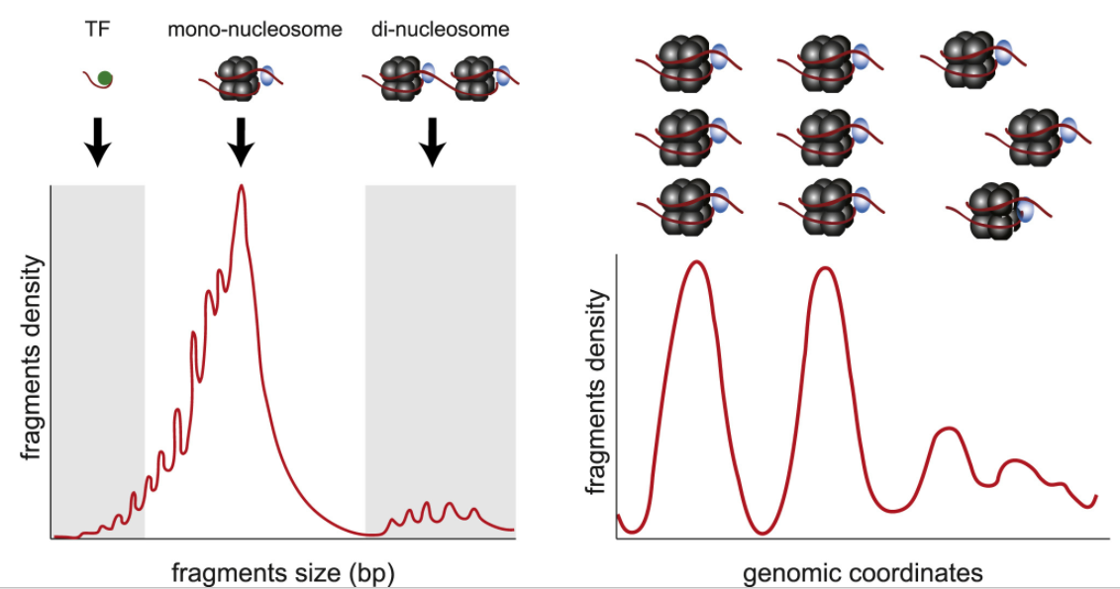
ctDNA fragment features and cancer phenotype?
cfDNA fragmentation patterns are biased by nucleosomes
Van der Pol and Mouliere, Canc Cell Rev, 2019; Murtaza and Caldas, Nat Gen, 2016
Nucleosome position reflects important cellular processes: gene transcription and transcription factor binding
→ can be inferred from ctDNA

Slide 35
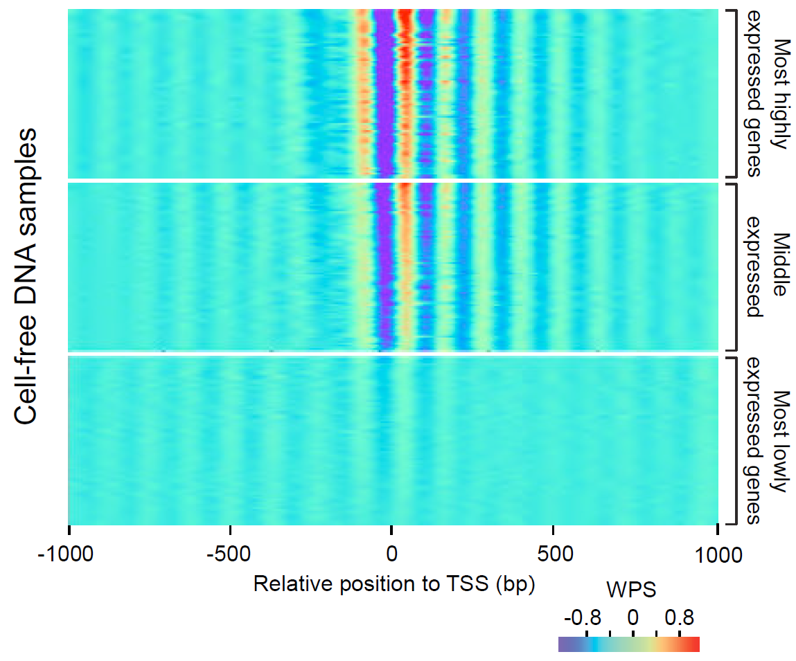
ctDNA nucleosome occupancy patterns recapitulate tissue mRNA abundance
Transcriptional start site
Generated per-sample nucleosome occupancy maps from cfDNA WGS and correlated results with whole-transcriptome sequencing of same-day metastatic biopsy
Highly expressed genes displayed features (in cfDNA) consistent with active transcription
nucleosome depletion at transcriptional start sites
strong +1 occupancy
well-ordered nucleosomes extending into first exon
Herberts, Annala, Sipola, et al. Nature 2022

Slide 36
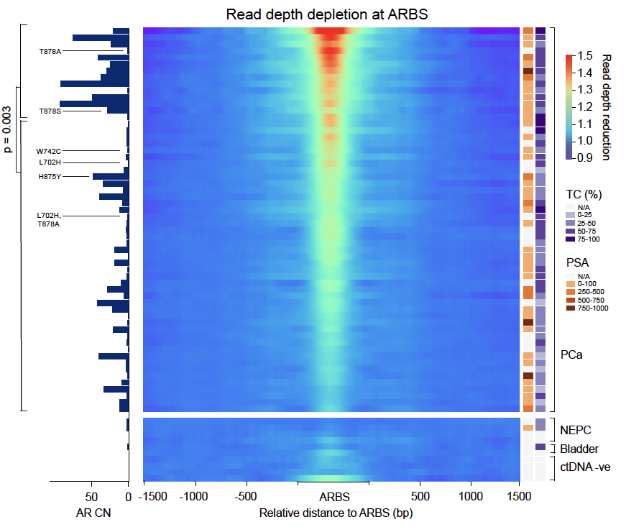
AR binding inferred from ctDNA WGS
Measured nucleosome occupancy at 3224 prostate-cancer AR-binding sites
Most samples exhibited strong ARBS nucleosome depletion = persistent AR signalling?
This signal was largely absent from ctDNA negative samples, bladder cancer, and NEPC
ARBS nucleosome depletion correlated with average AR gene and enhancer copy-number (but not PSA)

Slide 37
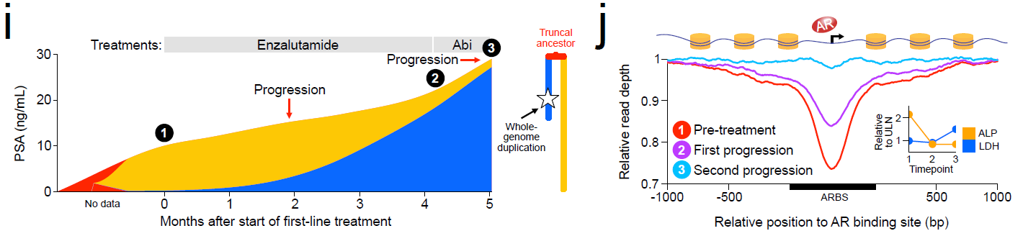
Identifying emerging lineage plasticity through ctDNA phenotyping
Complete loss of ARBS nucleosome depletion signal in the new population
Rapid expansion of a new population with an RB1 mutation
Herberts, Annala, Sipola, et al. Nature 2022

Slide 38
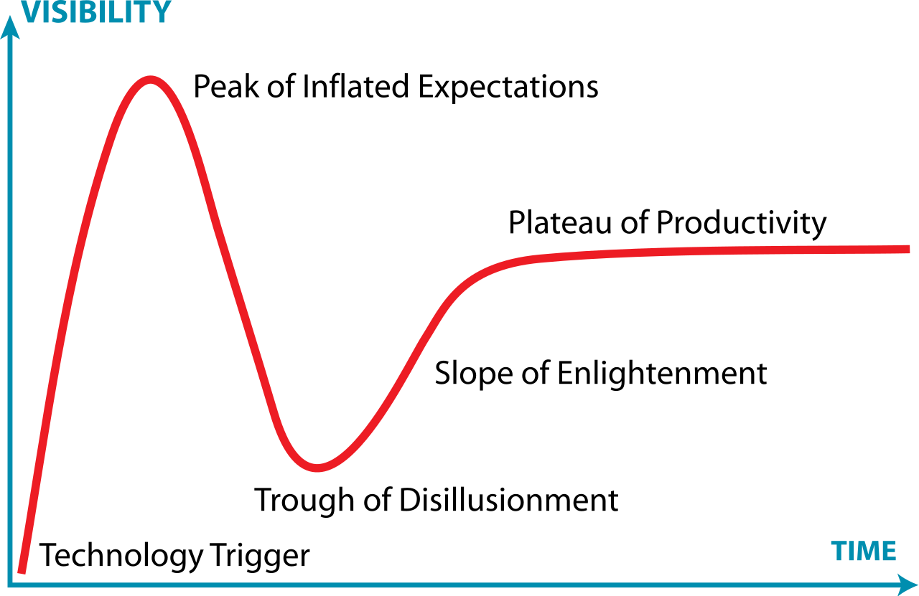
The hype cycle for new technology
ctDNA-based cancer genotyping is following the classic hype cycle
What triggered disillusionment?
False negatives (low ctDNA%)
False positives (CHIP)
No germline discrimination
Opaque test limits
Inadequate reporting of copy loss
Non-comprehensive assay designs
Poorly timed blood collections
Poor education of all the above
These challenges can be solved!
Graph modified from original by Jeremykemp at English Wikipedia, CC BY-SA 3.0, https://commons.wikimedia.org/w/index.php?curid=10547051

Slide 39
My thoughts on embedding genomic analyses in clinical trials
Trade-off between scientist ideals and clinician pragmatism
  Sample collection procedures must be easy & cheap
  Consider who will be performing the collections, potential confounders
Protocol can be a rough guide to future work
  Must justify sample collection, provide banking protocols & integrity safeguards
  Be judicious with committees, if work is not pre-planned
Trial budgets rarely cover correlatives
  Grant funding is often required; prelim data will help
Recognize that most people are pulling in same direction, are overworked and giving their time voluntarily, and do not understand scientific or clinical nuances that you may take for granted. Vice versa you may not understand the demands that you are placing on a strained system.

